Slide 1
Team Ink3D Status 2/21/14
Daniel Lain
Tim Edmonson
Shawn Simonson
Jesse Bowles

Slide 2
Project Status
Task Number | Task Name | Planned Start | Planned Finish | Planned Work Hours | Actual Work Hours | % Work Completed | Earned Vaule
2 | Senior Design 2 | Wed 1/15/14 | Fri 5/23/14 | 762 | 212 | 10.24 | 78
2.1 | Documents | Wed 1/15/14 | Fri 5/23/14 | 242 | 208 | 29.75 | 72
2.1.1 | Detailed Design Documnetation | Tue 1/21/14 | Thu 2/20/14 | 142 | 208 | 50.7 | 72
2.1.1.1 | Version 1.0 | Tue 1/21/14 | Thu 2/20/14 | 72 | 208 | 100 | 72
2.1.1.2 | Version 2.0 | Wed 2/21/14 | Tue 2/28/14 | 70 | 0 | 0 | 0
2.1.2 | Test Plan | Wed 2/21/14 | Tue 3/18/14 | 100 | 0 | 0 | 0
2.2 | Prototype Implementation | Tue 2/18/14 | Thu 5/15/14 | 500 | 0 | 0 | 0
2.2.1 | Version 0.0 | Tue 2/18/14 | Tue 3/4/14 | 100 | 0 | 0 | 0
2.2.2 | Version 1.0 | Tue 3/4/14 | Tue 3/18/14 | 100 | 0 | 0 | 0
2.2.3 | Version 2.0 | Tue 3/18/14 | Tue 4/1/14 | 100 | 0 | 0 | 0
2.2.4 | Version 3.0 | Tue 4/1/14 | Tue 4/15/14 | 100 | 0 | 0 | 0
2.2.5 | Final Product | Tue 4/15/14 | Tue 4/29/14 | 100 | 0 | 0 | 0
2.3 | Final Documetation | Tue 4/1/14 | Tue 4/29/14 | 10 | 0 | 0 | 0
2.4 | Architecture Design Version 2.1 | Tue 1/21/14 | Fri 2/21/14 | 10 | 4 | 60 | 6
2.4.1 | Modify Drawings | Tue 1/21/14 | Fri 2/21/14 | 2 | 2 | 100 | 2
2.4.2 | Fix Physical Layer(Printer Control Layer) | Tue 1/21/14 | Fri 2/21/14 | 2 | 1 | 100 | 2
2.4.3 | Add Communications Layer | Tue 1/21/14 | Fri 2/21/14 | 2 | 1 | 100 | 2
2.4.4 | Team Reviews | Fri 2/21/14 | Fri 2/21/14 | 4 | 0 | 0 | 0
3 | Presentations | Fri 9/13/13 | Fri 4/25/14 | 49 | 46 | 83.67 | 41
3.4 | Detailed Design Review | Thu 2/20/14 | Tue 2/25/14 | 7 | 18 | 100 | 7
3.4.1 | Peer Review | Mon 2/10/14 | Mon 2/10/14 | 2 | 0 | 100 | 2
3.4.2 | Prepare Presentations | Wed 2/19/14 | Wed 2/19/14 | 4 | 11 | 100 | 4
3.4.3 | DDS Gate Review | Thu 2/20/14 | Thu 2/20/14 | 1 | 7 | 100 | 1
3.6 | Team Stauts Report SD2 | Thu 1/23/14 | Fri 4/25/14 | 8 | 1 | 0 | 0
4 | Team Meetings | Tue 9/10/13 | Tue 12/9/14 | 496 | 169 | 66.13 | 328
4.2 | Team Meeting SD2 | Tue 1/14/14 | Thu 5/1/14 | 272 | 61 | 38.24 | 104
5 | Sponser Meetings | Mon 9/9/13 | Tue 9/9/14 | 30 | 20 | 0 | 0
6 | MS Project | Sun 9/29/13 | Thu 10/23/14 | 40 | 27 | 50 | 20
6.2 | SD 2 | Thu 1/23/14 | Thu 1/23/14 | 20 | 5 | 0 | 0

Slide 3
ME and Sponsor Meetings
Productive meetings
Demonstrated Printer
Proof of Concept Worked
Configuration Parameters Finalized
Scope Balance / Prevent the Creep

Slide 4
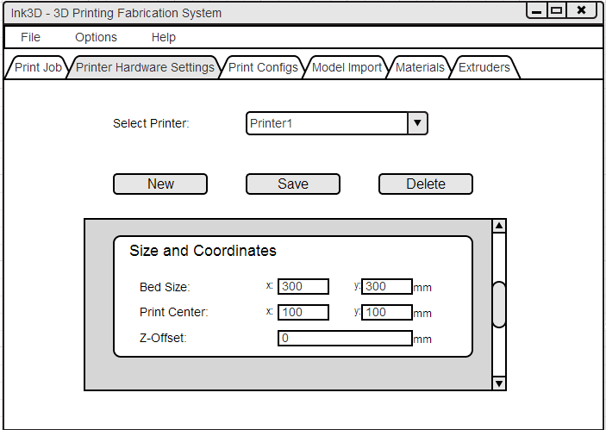
GUI Prototype

Slide 5
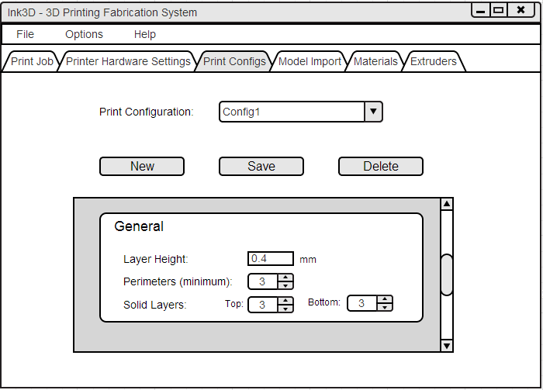
GUI Prototype

Slide 6
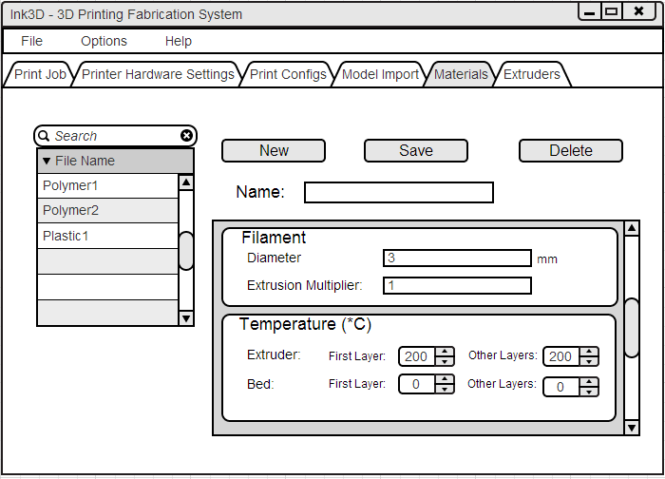
GUI Prototype

Slide 7
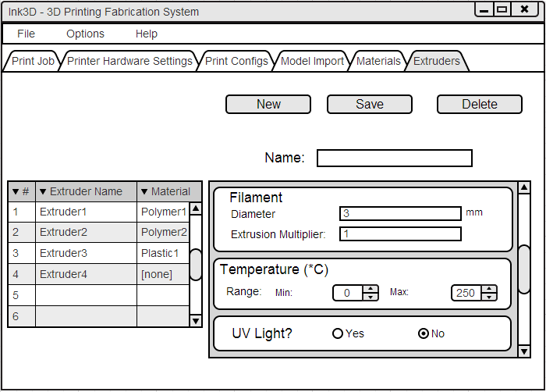
GUI Prototype

Slide 8
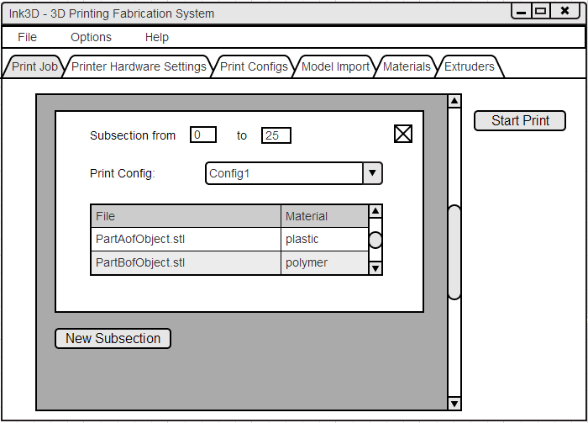
GUI Prototype

Slide 9
Subsections
Make sure we meet our sponsor’s needs
Provide “subsection” feature
Solutions
Write subsectioning algorithm ourselves
Use Blender
Use OpenSCAD

Slide 10
Serial Communication with RepRap Marlin
Problems:
Sparse Documentation
Dig through tons of C++ code.
Specifics are very unclear
Solution:
Look at some of the other RepRap firmwares that are well documented.
Look at the Rumba board’s USB controller documentation
Findings:
* Uses “Virtual Serial” communication. Behaves like a serial (COM) port, but uses the USB interface. USB is rather complicated

